Slide 1

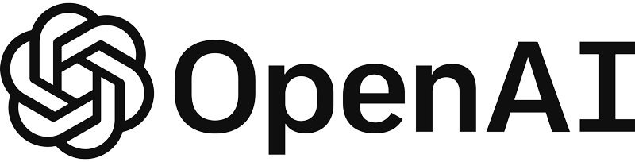
Build a PDF Q&A chatbot using Azure OpenAI and Streamlit

Slide 2
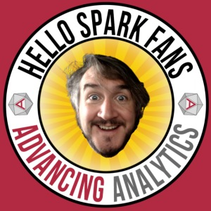










Gavita Regunath
Head of AI
www.advancinganalytics.co.uk
/AdvancingAnalytics
@AdvAnalyticsUK
totallyskewed.co.uk

Slide 3

Agenda
RAG
Streamlit

Slide 4
Prerequisites
VSCode
Python
Azure OpenAI

Slide 5
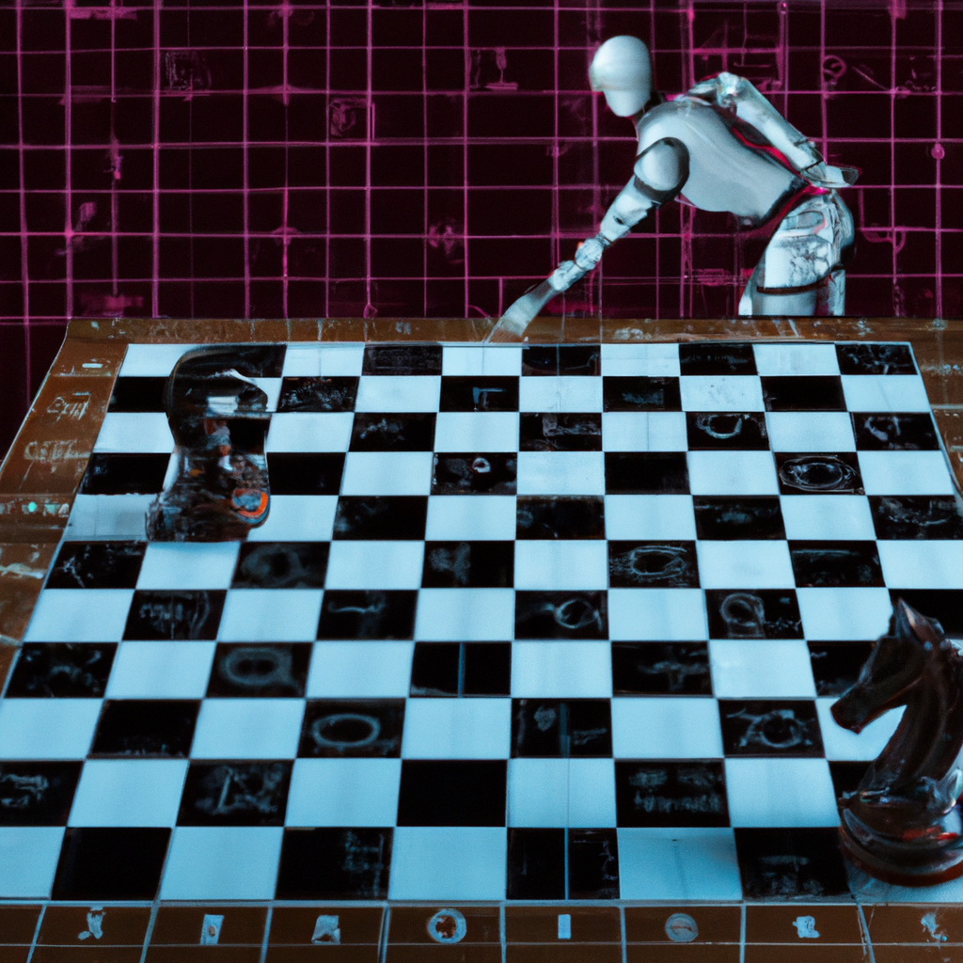
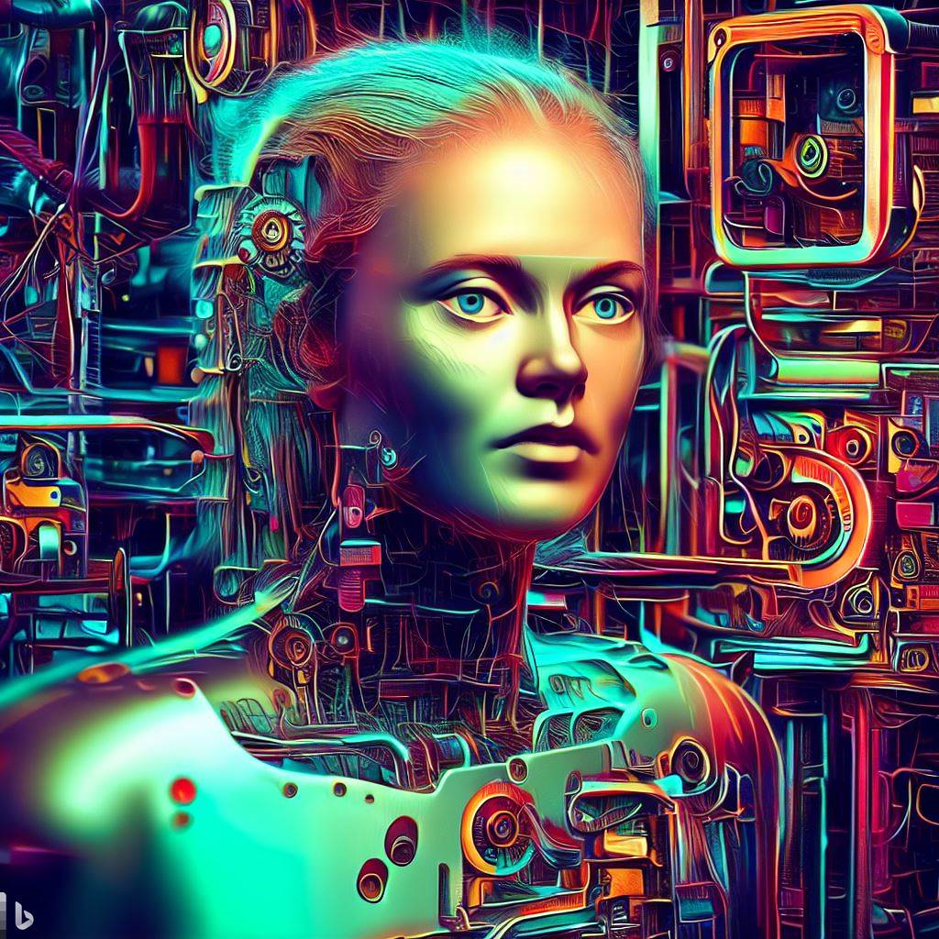
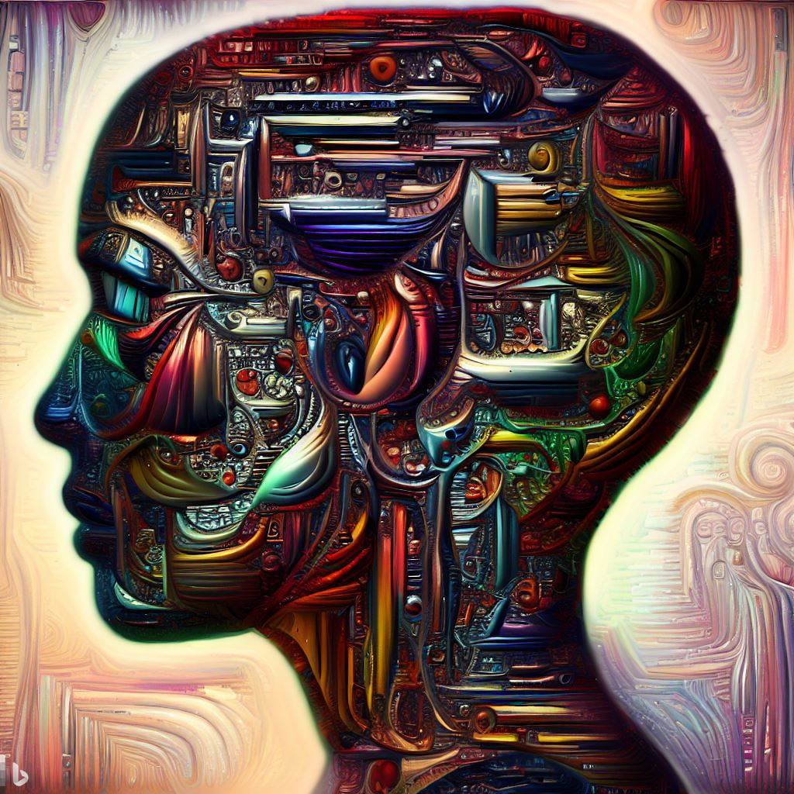
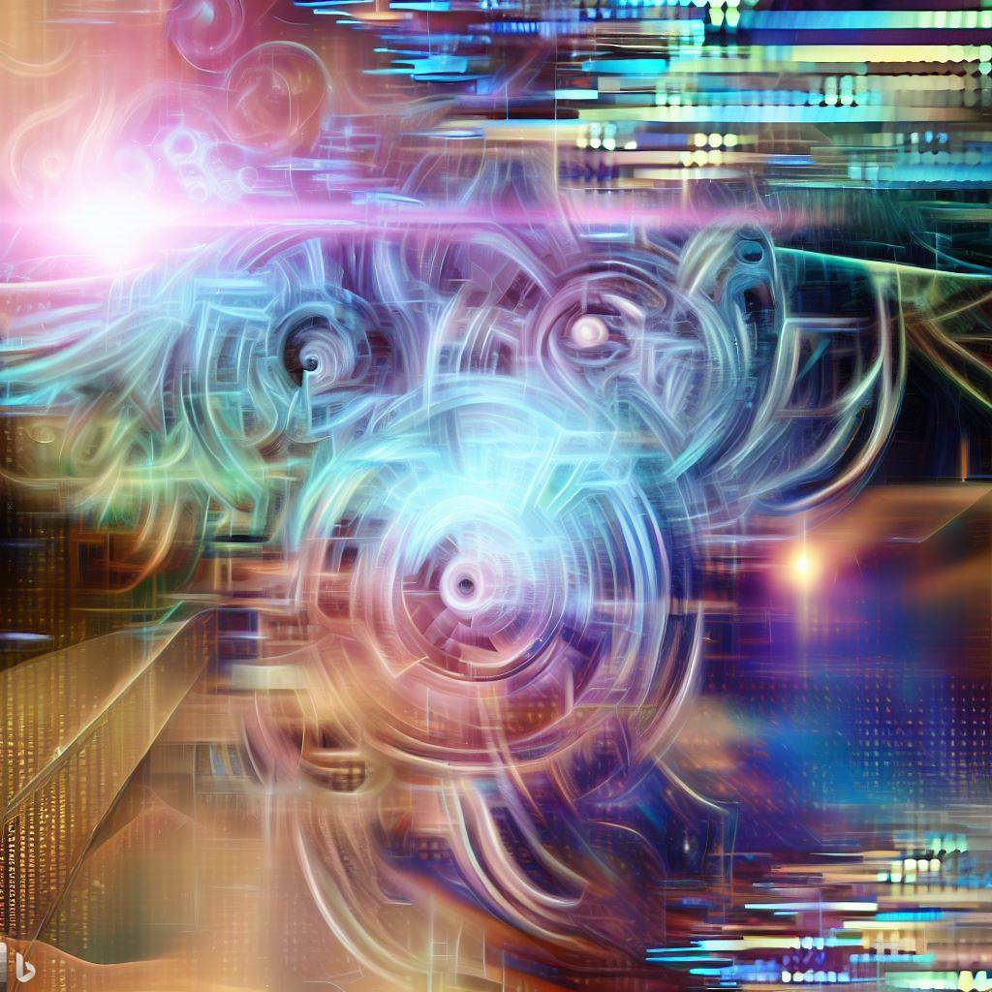
What is Generative AI?
1956
Artificial Intelligence
the field of computer science that seeks to create intelligent machines that can replicate or exceed human intelligence
Artificial Intelligence
1997
Machine Learning
subset of AI that enables machines to learn from existing data and improve upon that data to make decisions or predictions
Machine Learning
Deep Learning
2017
Deep Learning
a machine learning technique in which layers of neural networks are used to process data and make decisions
Generative AI
2021
Generative AI
create new written, visual, and auditory content given prompts or existing data.
Notes:
AI – field that imitates human behavior. checkers-playing computer
ML – subset of AI, uses algorithm to learn from data to make predictions
DL – subset of ML, uses complex NN architecture to solve complex problems
GenAI – subset of DL, able to produce new content based on the input
These images were generated by generative ai, Open AI dall-e model.

Slide 6
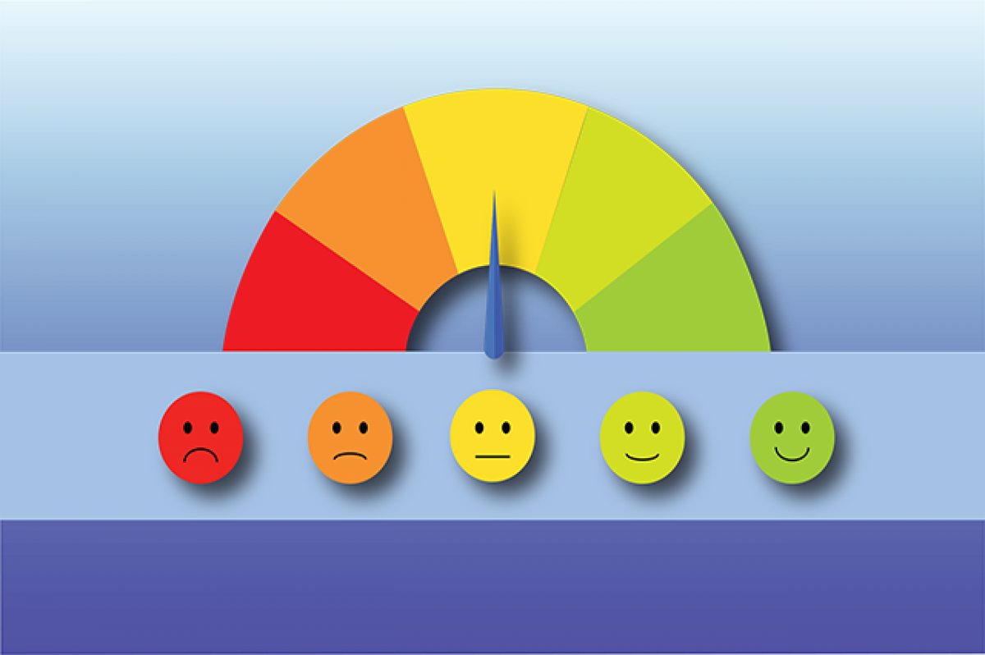

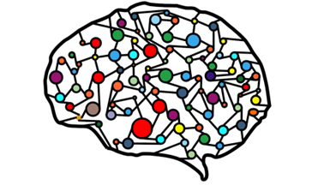

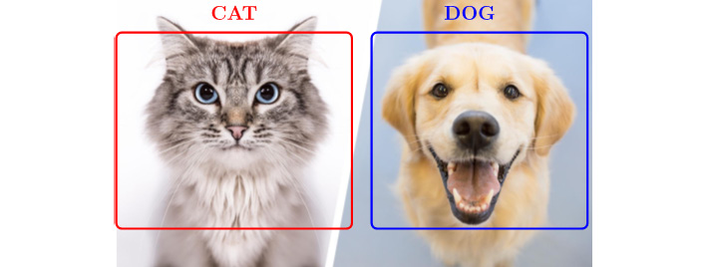

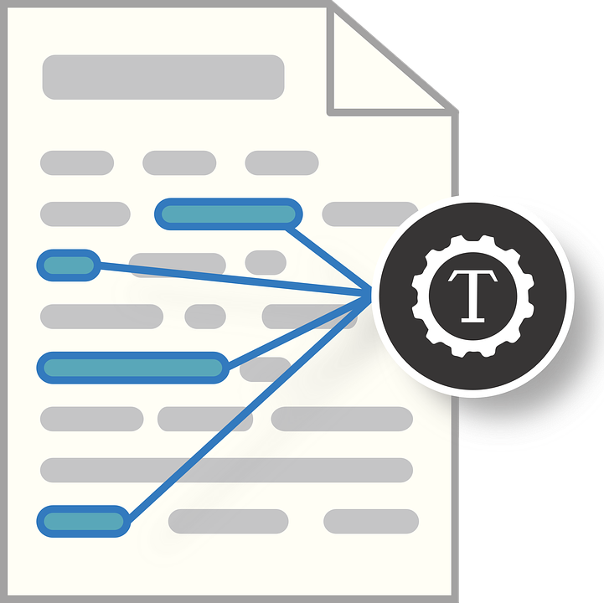


Traditional machine learning
Training Data
Individual Model
Tasks
Sentiment Analysis
Classification
Entity Recognition
Object Detection
Notes:
Difference between traditional ML vs Gen AI
Models are developed separately
If you want to do sentiment task specific model trained to do this particular task and they can’t be used more broadly
Classification model, entity recognition

Slide 7






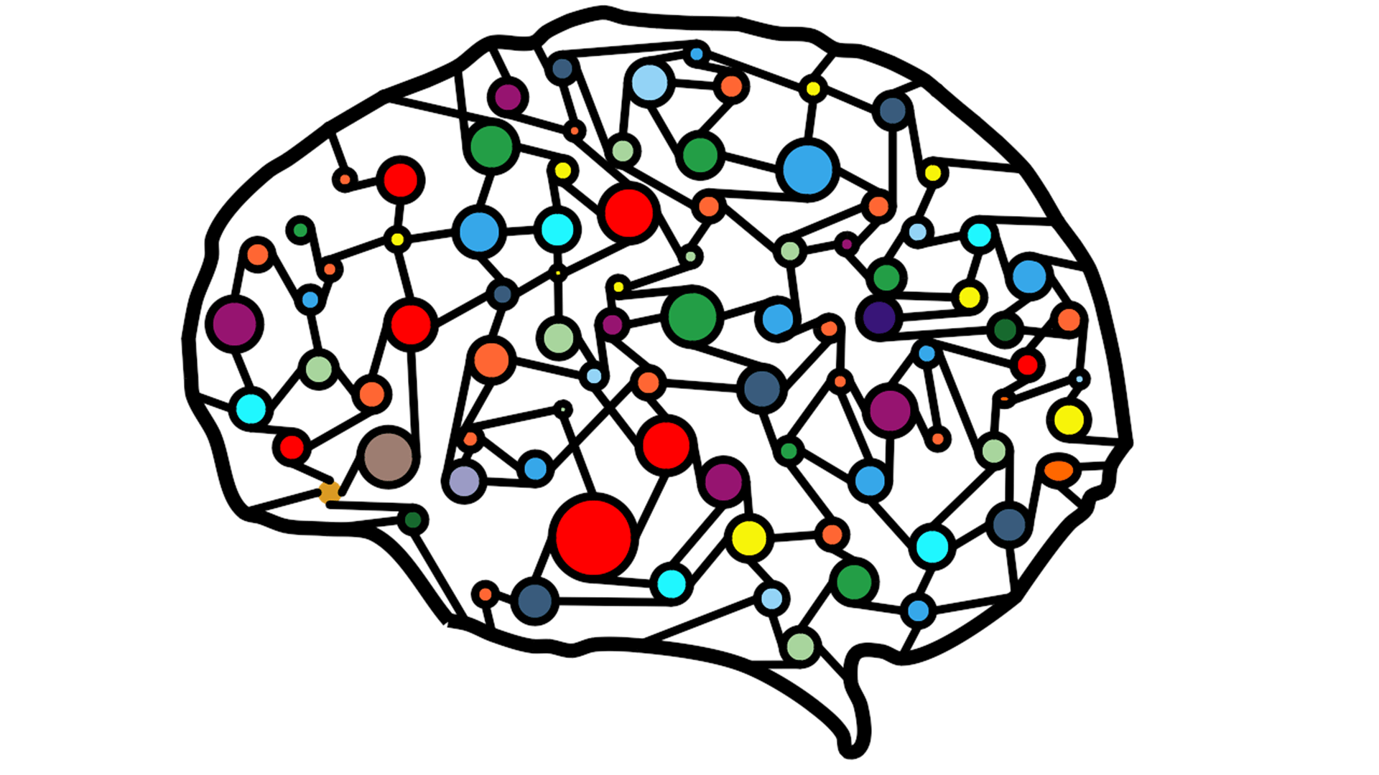
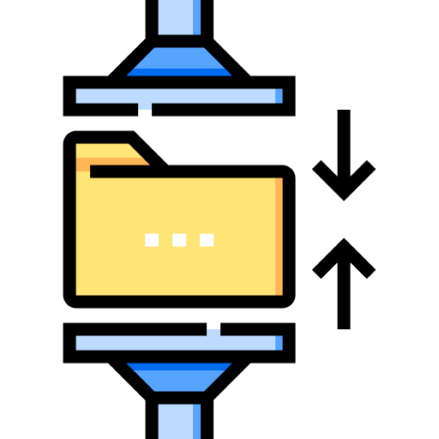


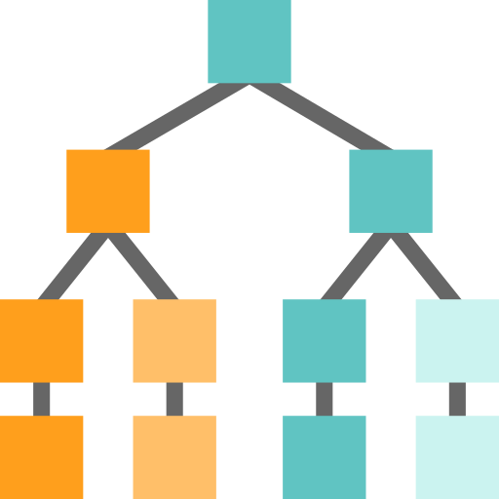



Generative AI is enabled by Large Language Models
Tasks
Question and Answering
Lakehouse Platform
Sentiment Analysis
Text
Information Extraction
Images
Speech
Image Captioning
Structured Data
3D Signals
Object Recognition
Data
Classification task
Generation task
Instruction Follow

Slide 8
Challenges of LLMs

Slide 9
Limitations
LLMs hallucinate
Presents real ethical and business concerns, so much so that for some it is a show stopper
1
2
LLMs do not have data context
Trained on open internet data that might not provide good responses
3
LLMs are a black box
Often requires interpretability, challenging understanding the reasoning behind their decisions
Speed and cost
LLMs are computationally very expensive, extraction from large documents can take up to tens of seconds.
4
Potential bias
Only as good as the data they are trained on, they are expected to have societal and geographical biases encoded in them
5
Lack of control
Even the best prompts cannot force the model to give consistently correct output.
6
Data residency and privacy
Control over data and privacy management is crucial for companies
7

Slide 10
Why Choose Streamlit for LLM Apps?
Interactivity by Default: Streamlit is a faster way to build interactive data apps. It’s also a lot of fun!
Ease of Use: It's simple, yet powerful, open source Python library enables developers and data scientists to easily create and share beautiful, custom web apps.
Deployment and Sharing: Streamlit has rapidly become the visual UI of choice for LLM-powered apps, including chatbots, sentiment analysis tools, content summarizers, and more.

Slide 11


Q&A chatbot
Azure OpenAI Service
Questions
?
Embedded question
text-embeddings- ada-002
User
Application
Azure AI Services
Section 1
Embedding 1
Vector
search
Azure OpenAI Service
Section 2
Embedding 2
Section 3
Embedding 3
N-Relevant Sections
text-davinci-003
Document Library
VectorDB
Section 4
Embedding 4
Azure OpenAI Service
text-embeddings-ada-002

Slide 12
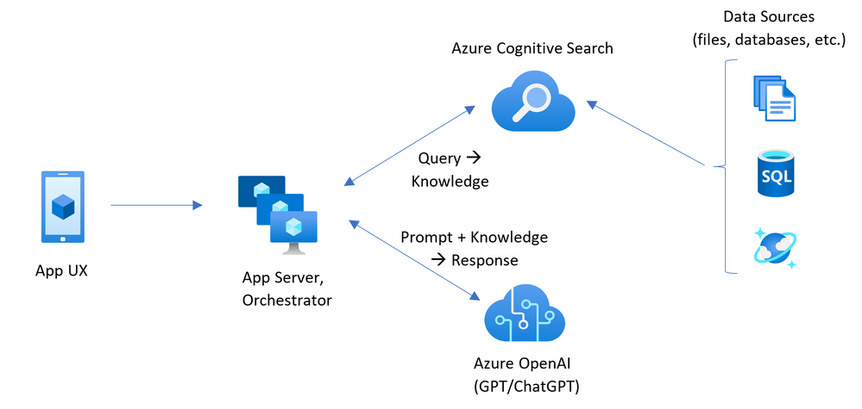
ChatGPT + Enterprise data with Azure OpenAI and Cognitive Search
Official Azure OpenAI Accelerators already exist

Slide 13
Why consider this architecture?
What if you want to run a Retrieval Augmented Generation (RAG) solution locally?
What if the customer wants flexibility in choosing a Vector Databases that is not AI Search?
What is the customer does not want to upload their data for embedding?
What if you want flexibility with chunking documents?

Slide 14
RAG In a Nutshell

Slide 15
Hallucinations
Lack of transparency
Uncontextualised data

Slide 16
Ability of an LLM to learn information not through training, but by receiving new information in a carefully formatted prompt

Slide 17
R A G
1
2
3
Retrieval
Get information from a database that relates to the question you asked.
Augmentation
Combine the retrieved information with the initial prompt
Generate
Pass the augmented prompt to a large language model, generating the final output

Slide 18





RAG Architecture: Using your own industry specific data
I need information about my recent car accident claim. What is the estimated value of the claim?
RAG Model
?
Search
Store
Embeddings
[010101001001]
Semantic search
Embeddings
[010101001001]
User
“Based on our records, the estimated value of your recent car accident claim is £12,500. Please note that this estimate is subject to review by our claims adjuster to ensure accuracy.”
Vector database
Knowledge base
Claim Documents
Prompt injection
Question + Context
Retrieval
{ }
Generate
Augmentation
User

Slide 19
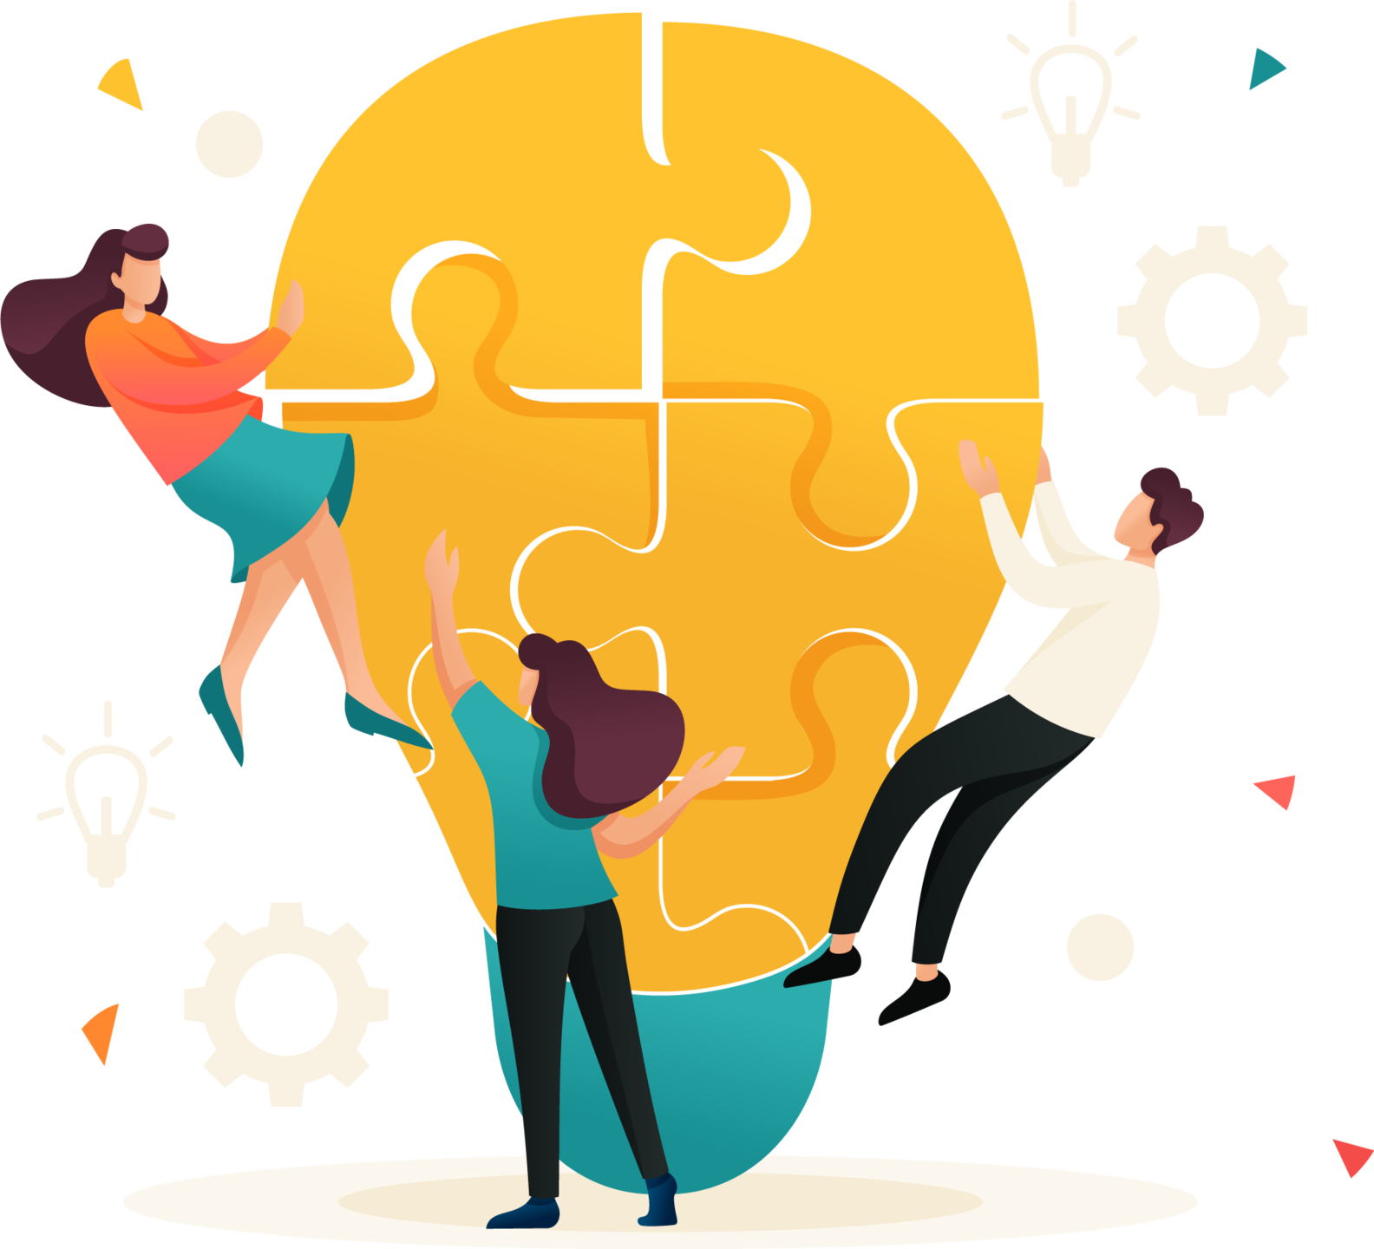
What problem do they solve?
Hallucinations:
RAG mitigates hallucinations by retrieving data from trusted sources, ensuring responses are grounded in factual information.
Lack of Transparency:
RAG offers transparency through retrieval, indicating the source of information, improving traceability, and identifying knowledge base issues or biases.
Contextual Understanding:
RAG enhances context by combining retrieval with generation from a knowledge base, resulting in more contextually relevant and accurate answers.

Slide 20
Real world examples with RAG

